Slide 1


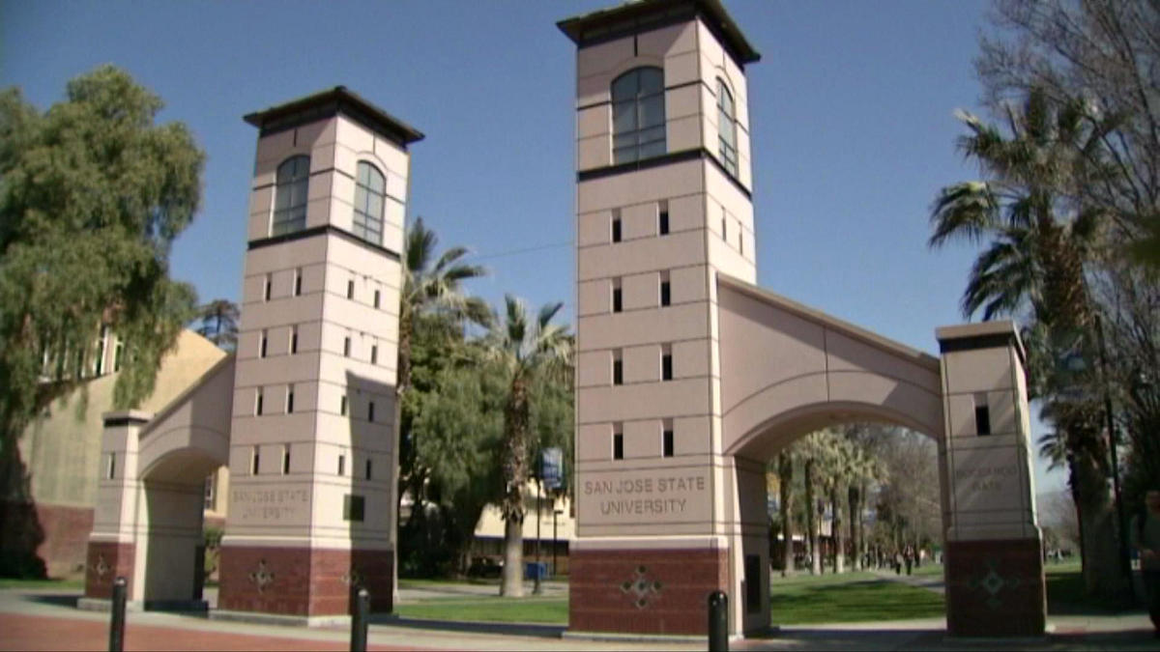
AI Testing – Case Study and Experience
Presented by: Jerry Gao, Professor, and Director
San Jose State University – Excellence Research Center on
Smart Technology, Computing, and Complex Systems

Slide 2
Some Mobile AI System Examples
Virtual Personal Assistant Google’s Allo, Apple’s Siri, Microsoft’s Cortana
Smart Cars Google’s autopilot project
Music and Video Recommendation systems YouTube, Netflix
Video games Call of Duty, Star Craft II, FIFA Journey
Prediction for Retail giants Amazon, Walmart
Fraud Detection for Banks Visa, Mastercard, PayPal
Customer Support Using chatbots to communicate, ex Lenovo.com, Dell.com
Smart Home Devices Lights turn on as you walk

Slide 3
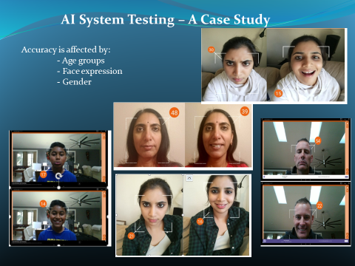
AI Software Testing – Case Study I – Tell Me Age

Slide 4
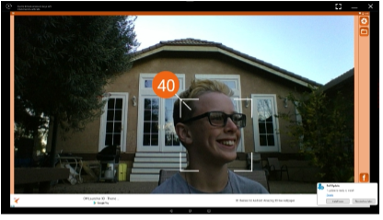
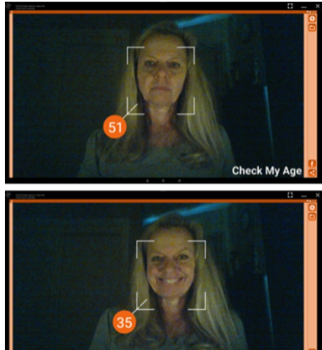
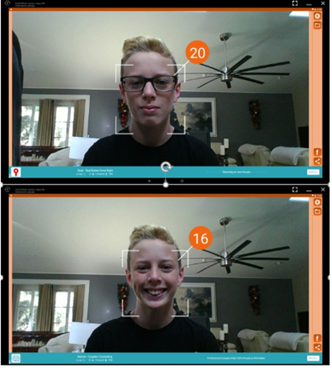
AI System Testing – A Case Study – Tell Me Age
Accuracy is affected by:
- Lighting Condition
- Personal Ware / Hair Style,…..
- Background Objects in the image

Slide 5
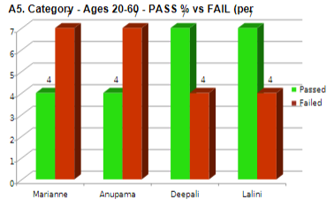
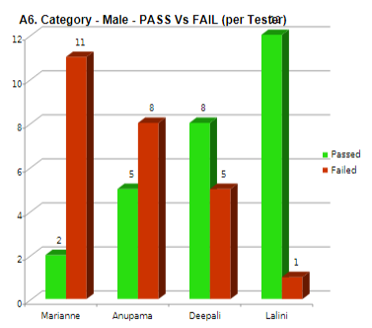
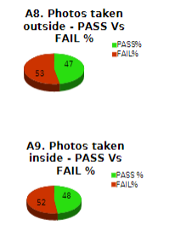
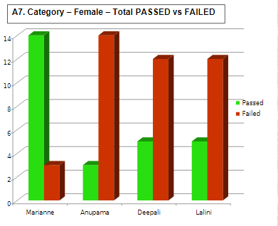
AI System Testing – A Case Study – Tell Me Age

Slide 6
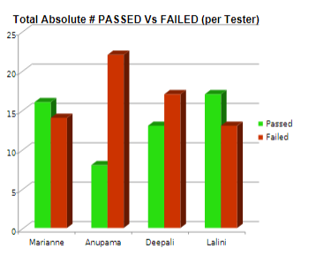
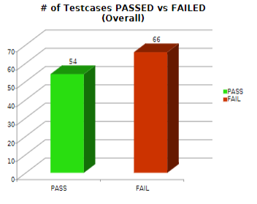
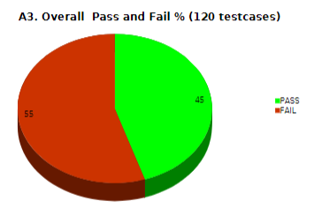
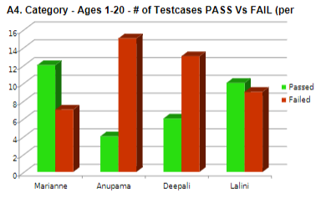
AI System Testing – A Case Study – Tell me Age

Slide 7

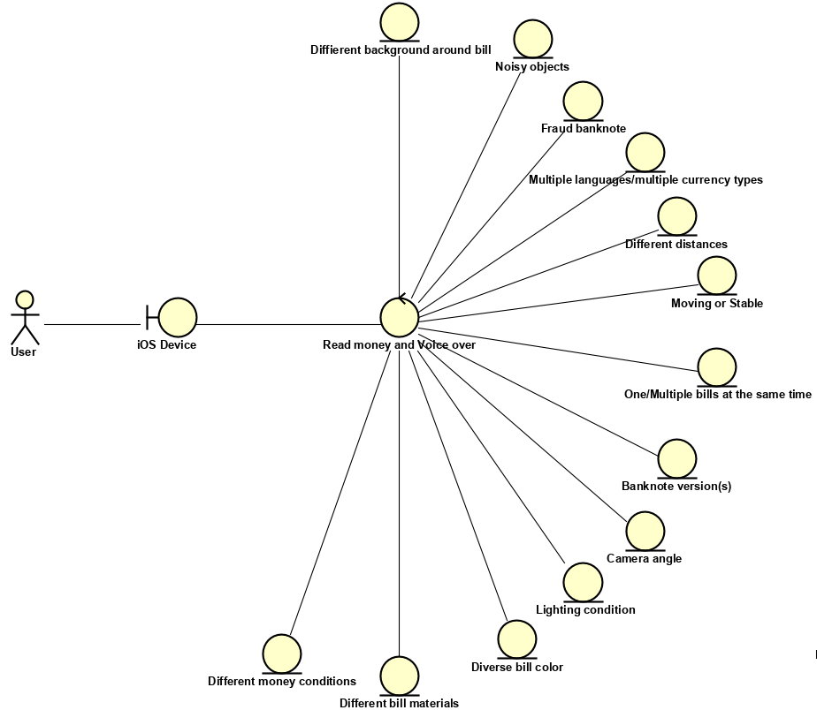
Testing LookTel Money Reader AI Functions
AI Function Features

Slide 8
USING CONVENTIONAL TESTING METHOD
To leverage the testing effectively in a short time, we apply some basic standard conventional testing methods to this mobile app.
Decision Table
Decision table testing is a kind of testing is more like a cause-effect testing. This testing will determine what kind of output will be obtained on giving various kinds of input with different kind of circumstances. Security holes can be detected in this method. The testing coverage area will be as follow: a) Checking multiple testing condition setup; b) Validate the money reader over some kinds of money material.
Scenario testing
This method is helpful to go through from the beginning state to any states of product without any technical view, only focus on user real experience. In this application, some test cases cannot be created by decision table or equivalence partition because it depends on testing setup and supported features on mobile, not application itself. That’s the reason why we need to use scenario. Test coverage: This method will be used in testing application on different types of supported equipment, with supported features on each, like: voice over setup, voice quality, text displaying, …
Equivalence partitioning
The application involves in detecting the bills from many countries and each country will have different set of bills of different value. This gives us a wide range of input, further which can be partitioned into classes. From each class, a particular kind of input is chosen as given as input. This kind of testing saves the time of the tester and reduces the tester’s workload. Test coverage: This method will help us to cover testing the feature of checking money reader’s detection and voice over capabilities on some range of language system around the world. Base on some defined test methods above, we designed our test cases for each business requirement domain follow each testing technique.

Slide 9
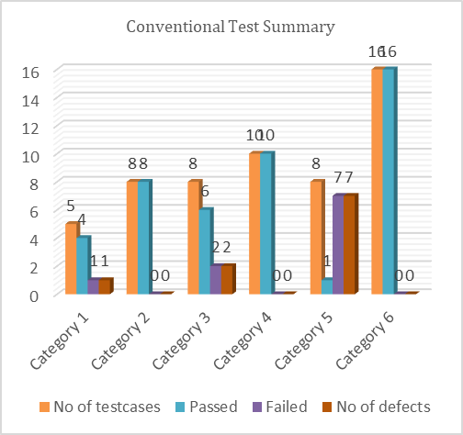
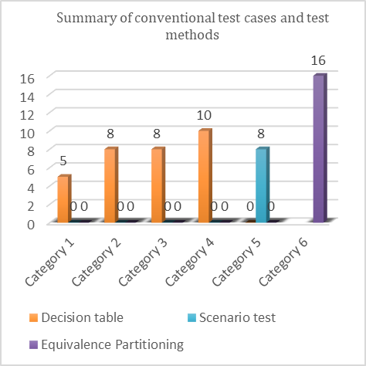

Slide 10
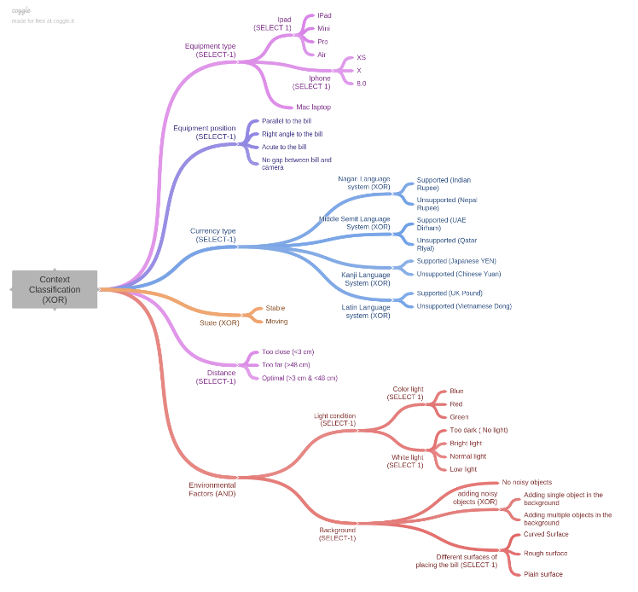
3D Money Reader - Context Tree

Slide 11
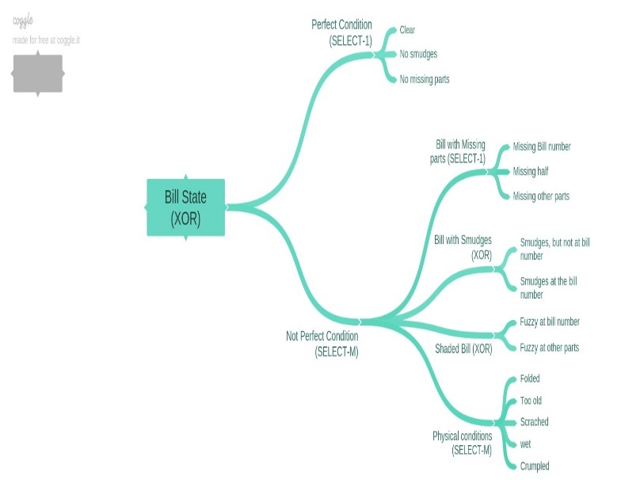
3D Money Reader – Input Tree (Bill State Classification)

Slide 12
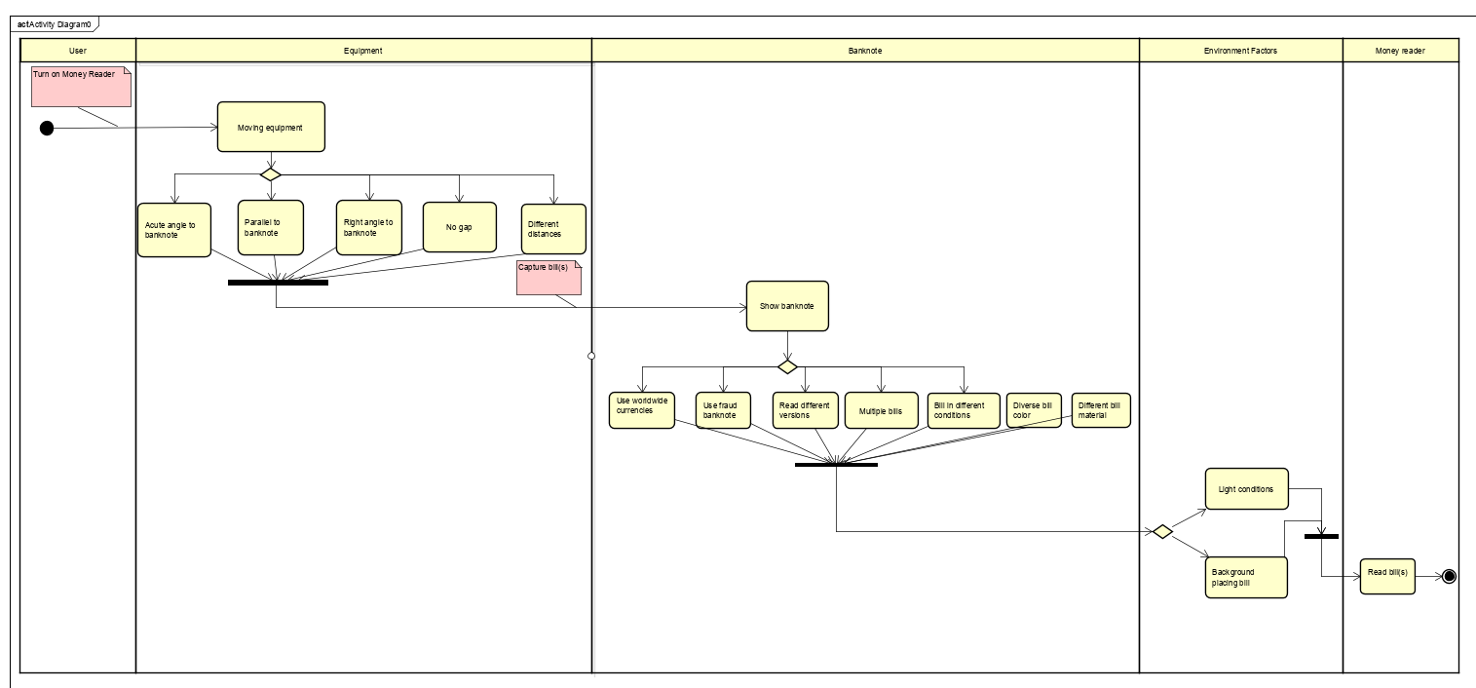
Money Reader - AI Function Events

Slide 13
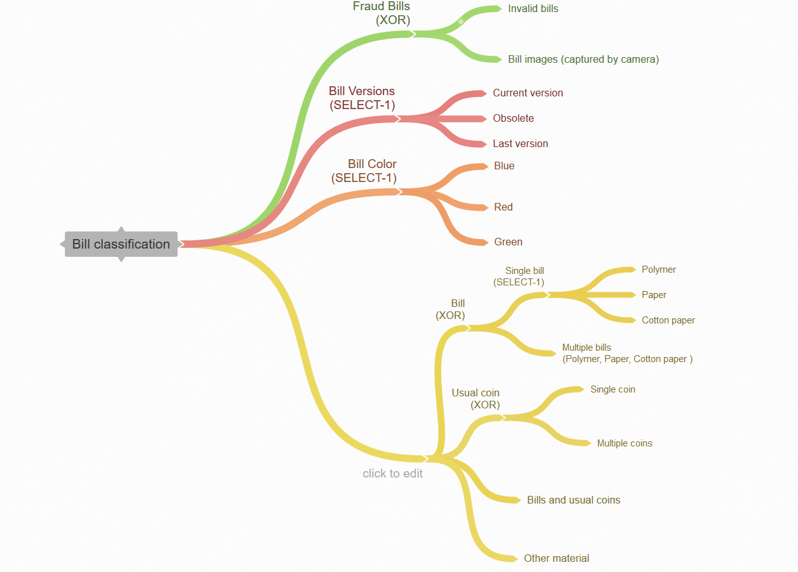
3D Money Reader – Input Tree (Bill Classification)

Slide 14
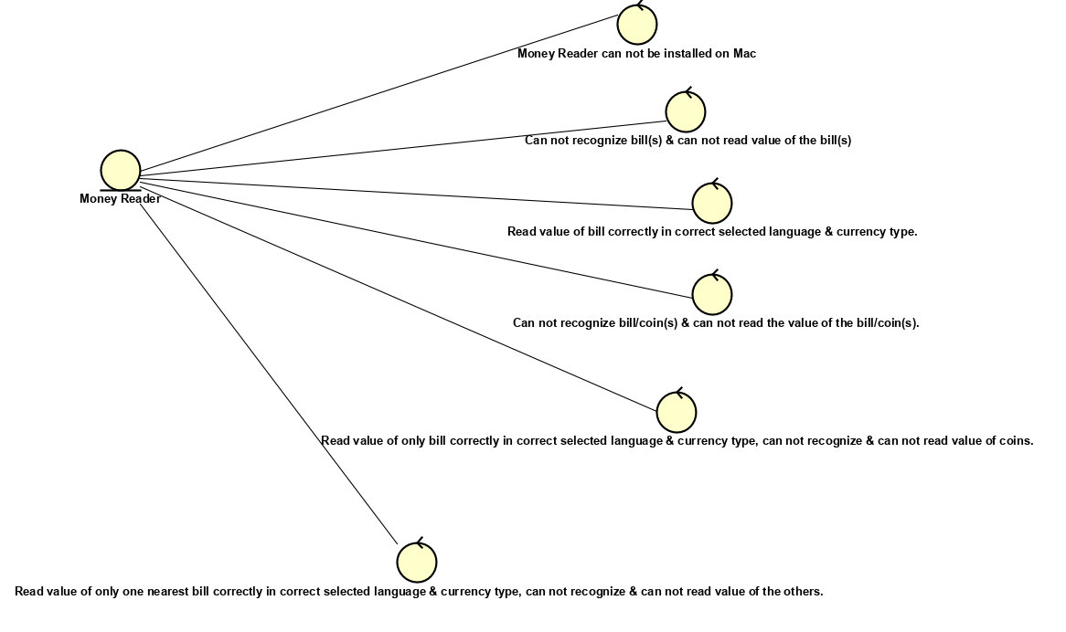
3D Money Reader – Output Tree

Slide 15
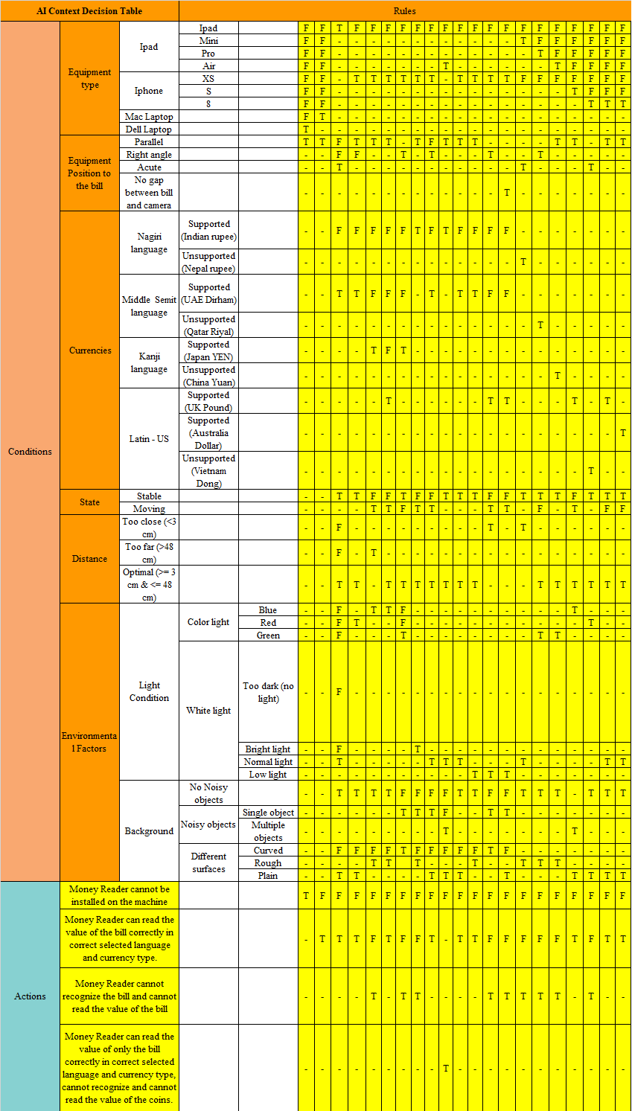
Money Reader - AI Context Decision Table

Slide 16
Money Reader - Bill State Decision Table (State Classification)

Slide 17
Money Reader - Bill State Decision Table (Bill Classification)

Slide 18
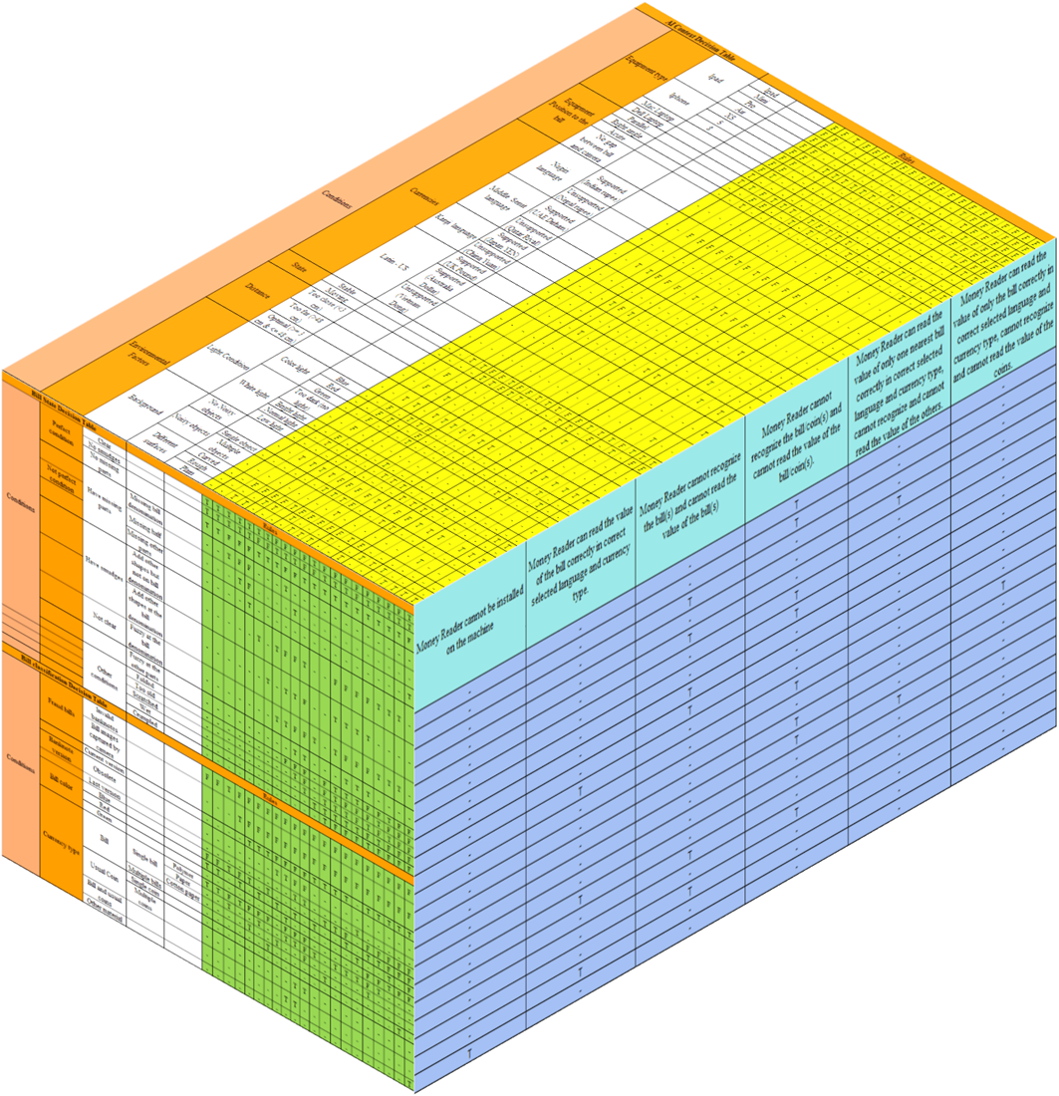
Money Reader - 3D Decision Table

Slide 19
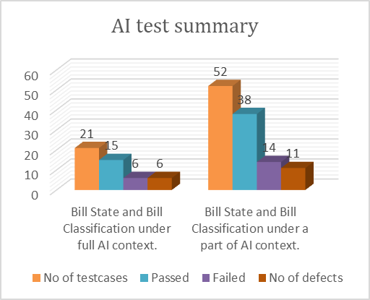
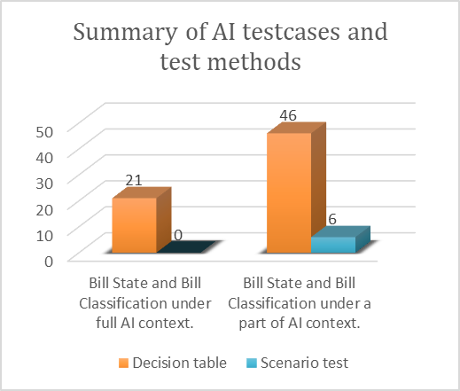
Money Reader - AI Test Summary
Summary of AI Testcases and Test Methods.

Slide 20
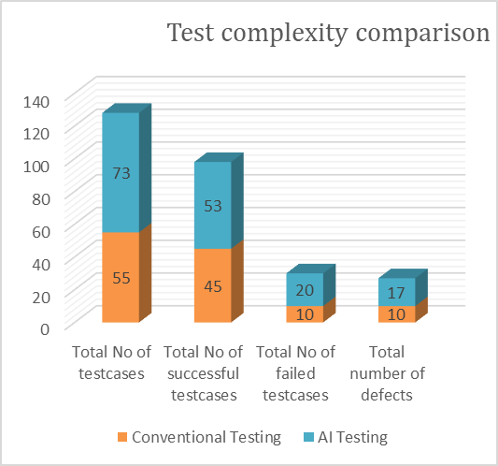
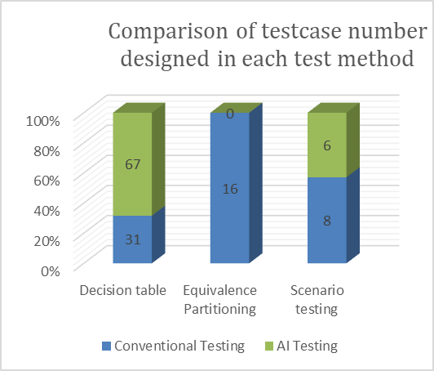
Test Complexity Comparison Between Conventional Testing and AI Testing.
A Comparison of Testcase Number Designed in Each Test Method.

Slide 21
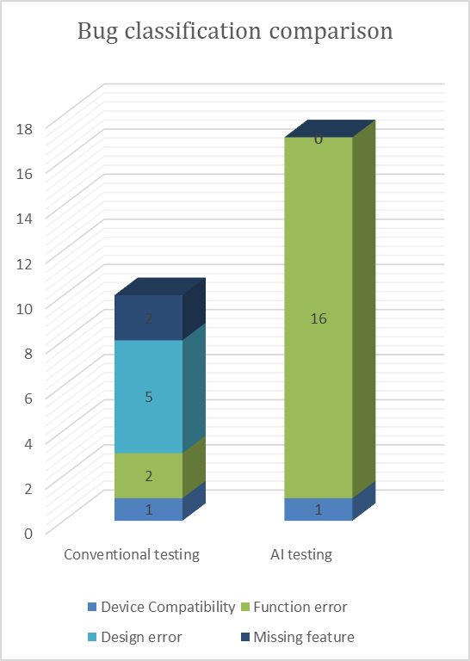
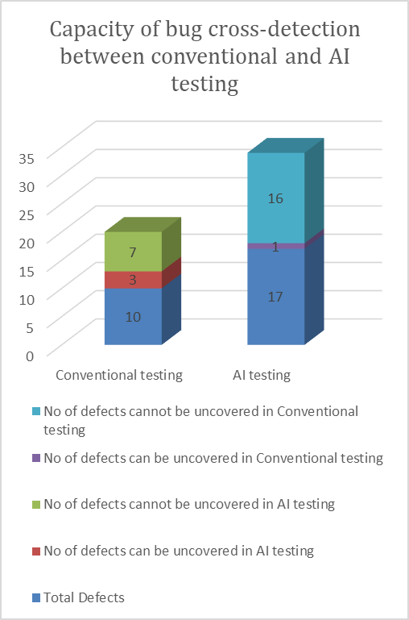

Slide 22
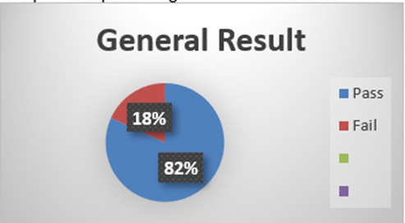
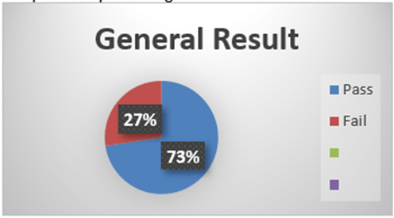
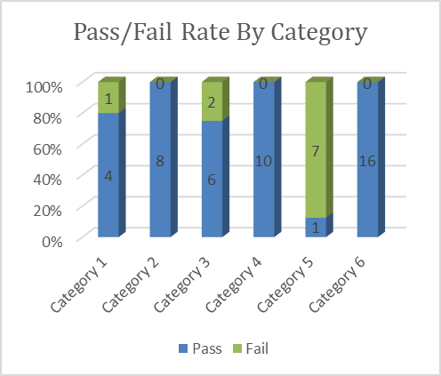
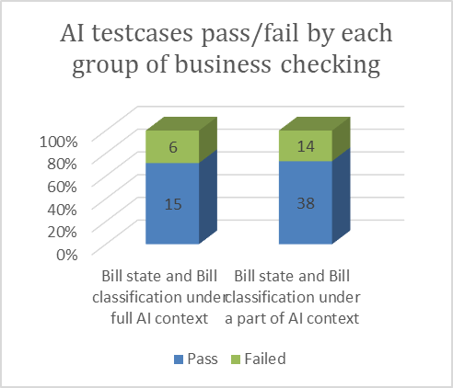
Conventional General Test Result
AI General Test Result

Slide 23
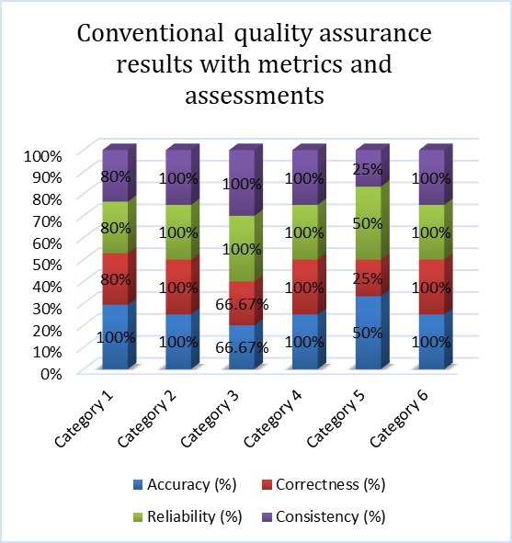
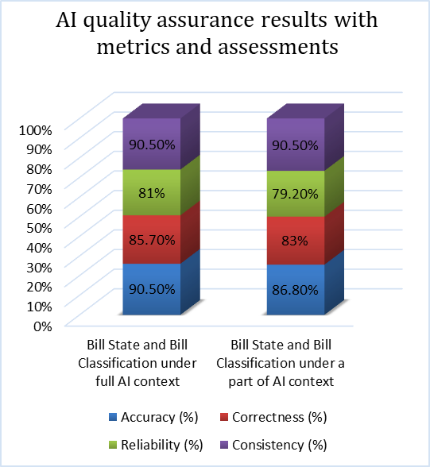

Slide 24
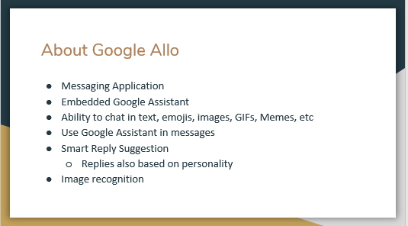
AI System Testing – A Case Study – Google Allo

Slide 25
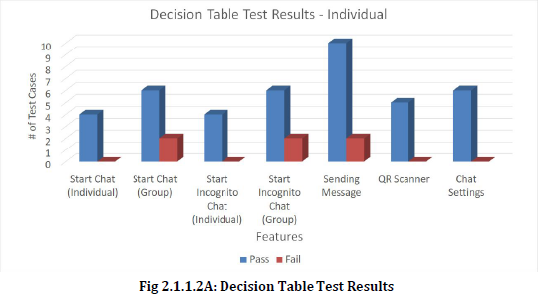
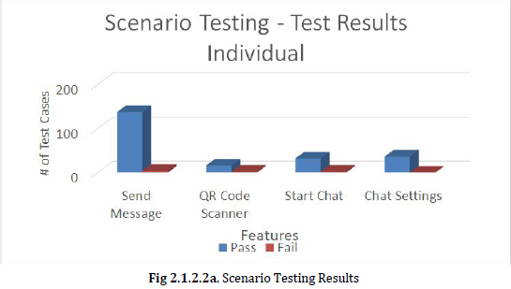
AI System Testing – A Case Study – Google Allo
The following are the areas of the application that we cover:
1. Start Chat feature of Google Allo
2. Send Message feature of Google Allo
3. QR code feature of Google Allo
4. Chat Setting feature of Google Allo

Slide 26
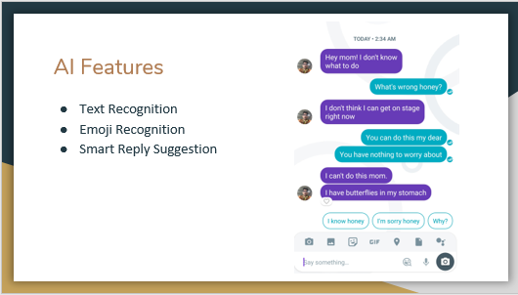
AI System Testing – A Case Study – Google Allo

Slide 27
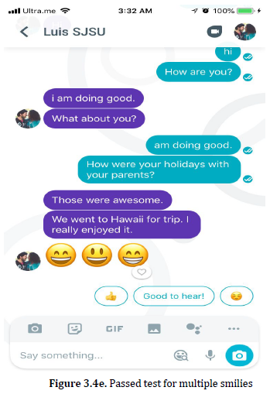
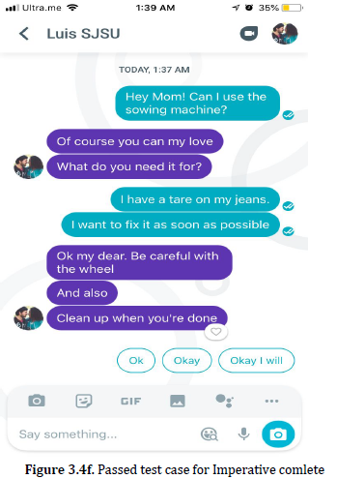
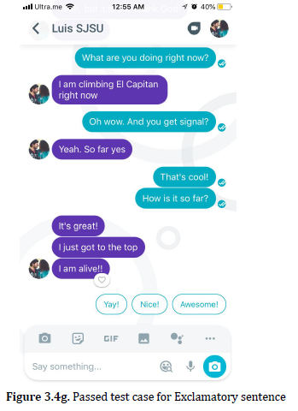
AI System Testing – A Case Study – Google Allo

Slide 28
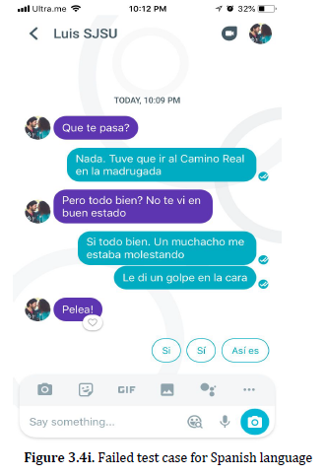
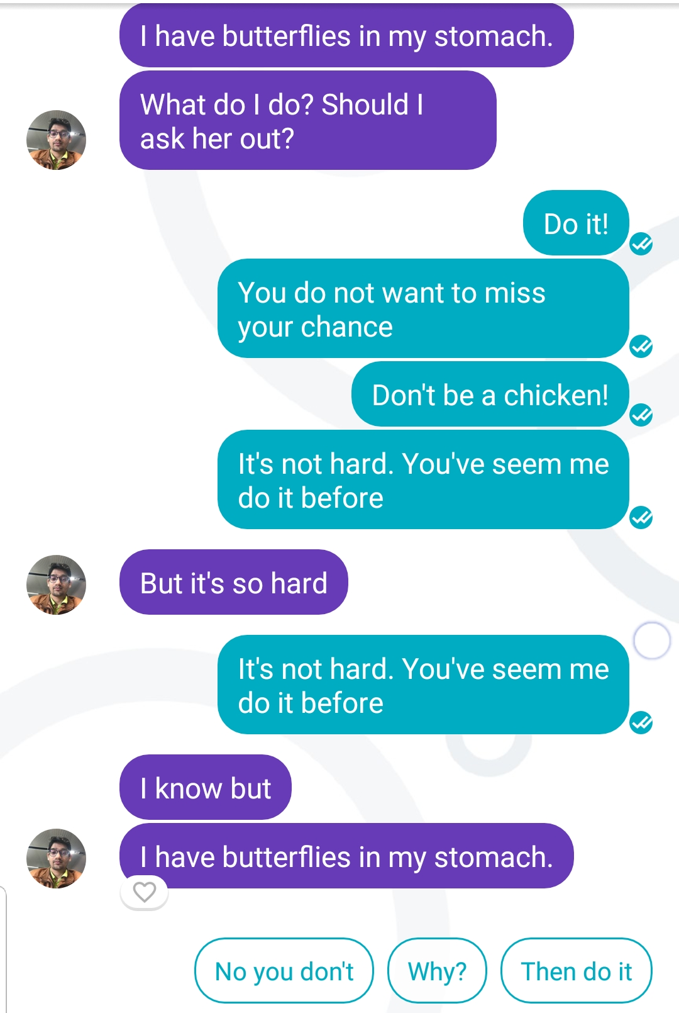
AI System Testing – A Case Study – Google Allo
Explanation:
In this chat, we see 1 person asking another how he is doing and other telling him that he punched a guy in face. When first person responded with Pelea! , we expected to see something related to fight, but only one suggestion was relevant. We considered it a fail for 2 reason, first being just one relevant suggestion and other one is that it gave 2 similar suggestion, which should not be the case.
Reason for not enough relevant suggestion could be that AI was not trained enough for Spanish which we could see with so many test getting failed.

Slide 29
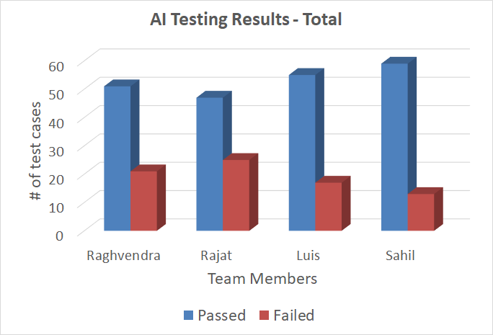
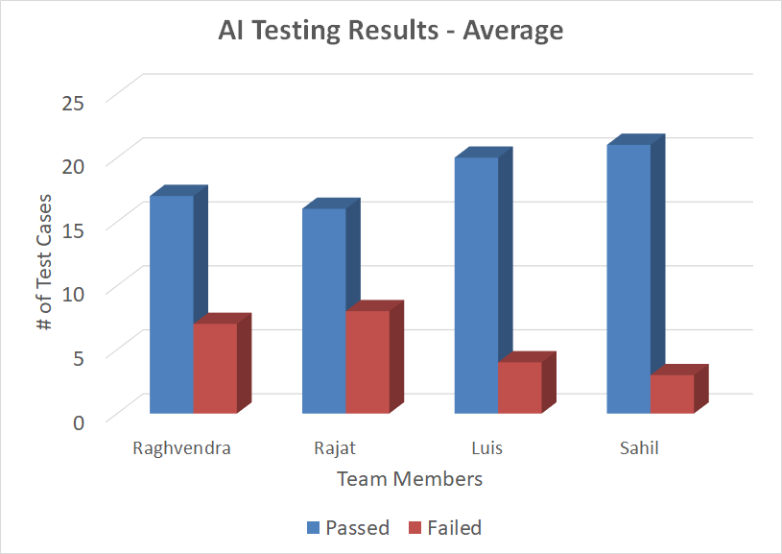
AI System Testing – A Case Study – Google Allo
AI Testing - Results

Slide 30
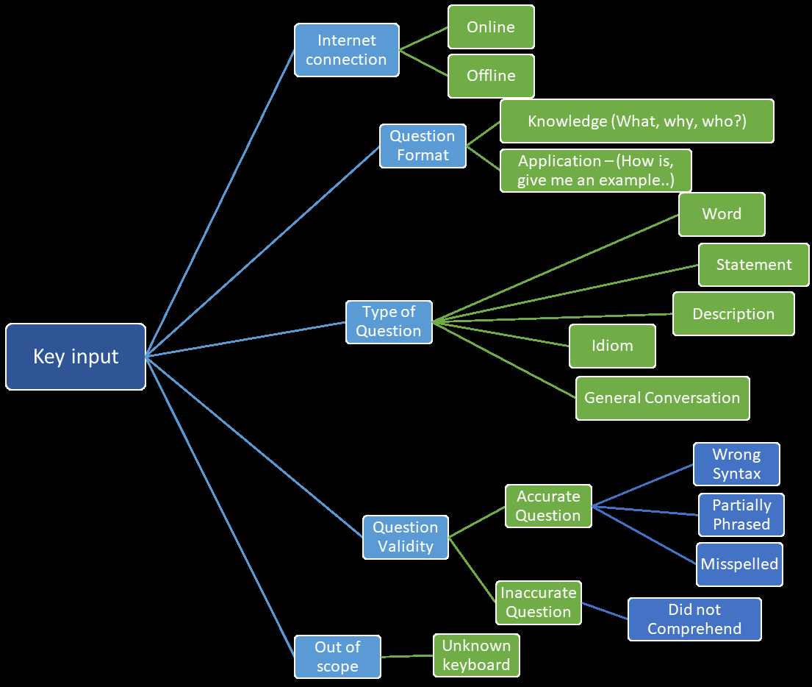
AI System Testing – A Case Study – Google Allo
AI Testing Model

Slide 31
AI System Testing – A Case Study – Google Allo
AI Testing Model

Slide 32
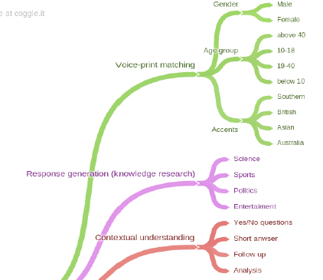
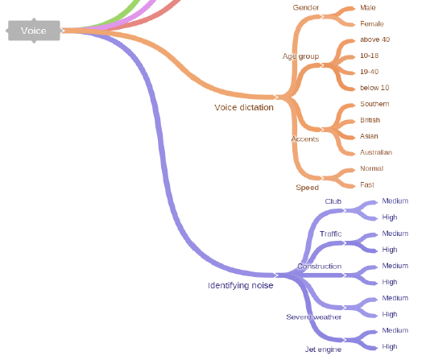

AI System Testing – A Case Study – Google Allo
AI Testing Model

Slide 33
AI System Testing – A Case Study – Google Photo

Slide 34
AI System Testing – A Case Study – Google Allo
Observations:
There needs to be context for smart replies to become relevant
Smart reply takes literal meaning of Idioms
Emojis are better recognized with text attached to them
English and Hindi had better performance than Spanish
Onomatopoeias are not recognized
Experience and Lessons Learned:
AI testing is more challenging than conventional testing
Difficult to cover all possible contexts, content, external factors
Automated data generating tool would make AI testing relatively easier to execute
Proper training and context are the prerequisites for smart replies
Still a long way to go for AI

